Slide 1


Risk Optimization: The Debt Consolidation
Strategy
Analytical Report
By Mikhael Putra Iswanto

Slide 2
METHODOLOGY
Business Understanding
Cleaning & Aggregation
Analysis & Visualization
Insights & Recommendation
Understanding business problems, setting objectives, and project scope
Collecting data and ensuring data quality with SQL
Performing data analysis to generate insights with SQL and Tableau
Effectively communicating insights and recommendations to solve problems
Desclaimer : Any reference to its services or data analysis methods is illustrative only. This scenario is designed to showcase the skills of a data analyst and is not associated with any financial institution. Any similarities to actual companies are purely coincidental.

Slide 3
01 Business Understanding
ABOUT US, BUSINESS PROBLEM, ROOT CAUSE ANALYSIS

Slide 4
ABOUT US
RevoFin is a Fintech company that provides innovative lending solutions for individuals and small businesses. It revolutionizes the borrowing experience using technology and data-driven insights. Its primary revenue model is based on transaction fees and loan interest.
BUSINESS PROBLEM
How Revofin can optimize its risk-based pricing strategy for a $2.8 billion portfolio with 176,087 customers, where analysis shows that debt consolidation customers (58.96% of low performers) have a distinct risk profile that is not yet reflected in pricing differentiation within 6 months.
OBJECTIVE
TOOLS & METHODS
Outlining the total outstanding loan amounts,
Highlighting key risk metrics, and
Examining both loan characteristics and customer attributes to uncover meaningful patterns or potential risk areas.
Data Processing - SQL (Cleaning Data & Aggregation)
Visualization - Tableau
Statistical Analysis - EDA, Cohort, Correlation, Customer Segmentation

Slide 5
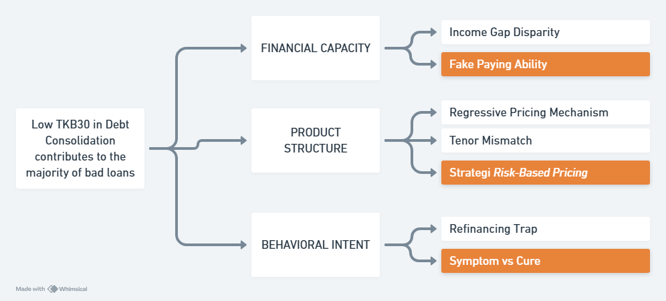
Root Cause Analysis

Slide 6
02 Analysis
EDA, INSIGHT, DATA VISUALIZATION

Slide 7



LOAN OVERVIEW PORTFOLIO
CUSTOMER
OUTSTANDING
ENDING NET RECEIVABLES
TKB 30
176.087
$2.801.078.850
$2.800.883.575
98.11%
12 = $195.275 Default

Slide 8
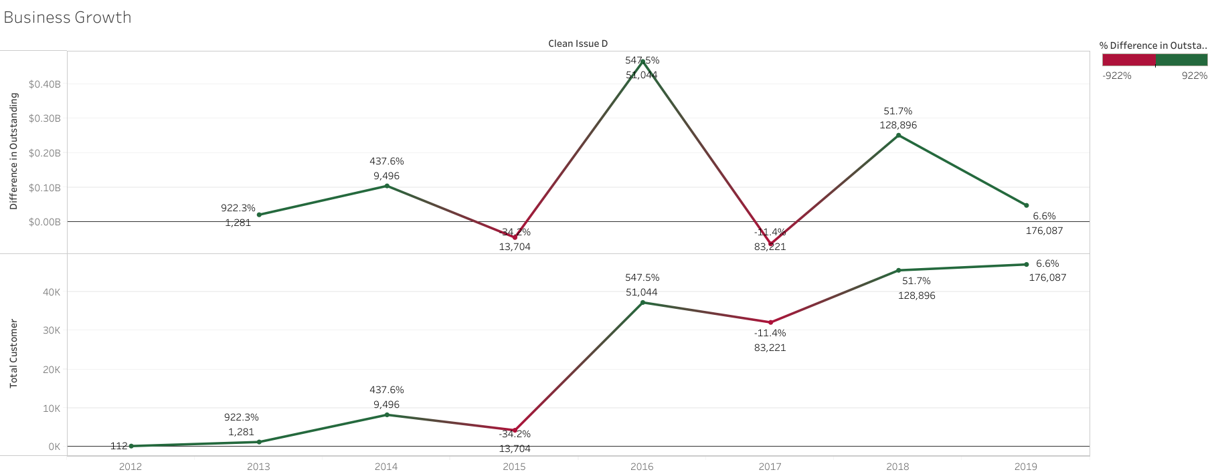
Business Growth

Slide 9
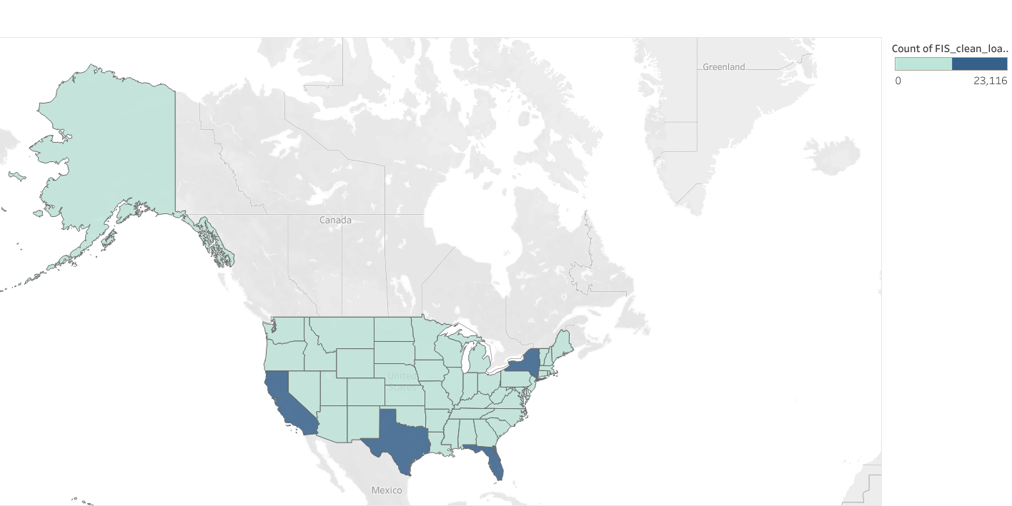
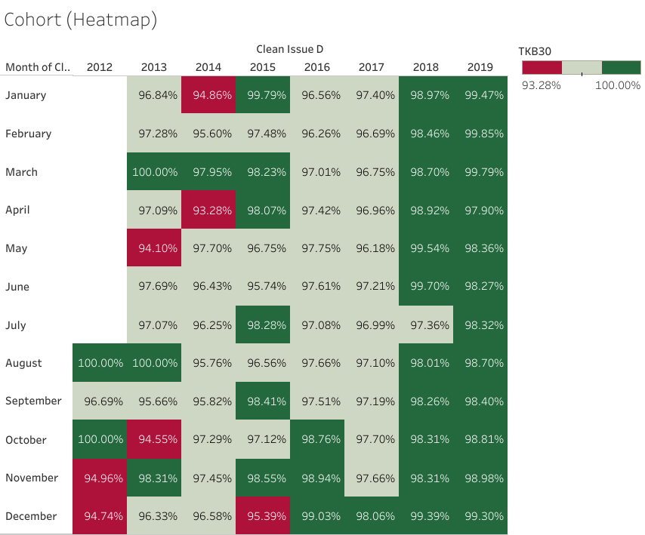

51
Portfolio Health Overview:
Strong but Needs Attention

Slide 10
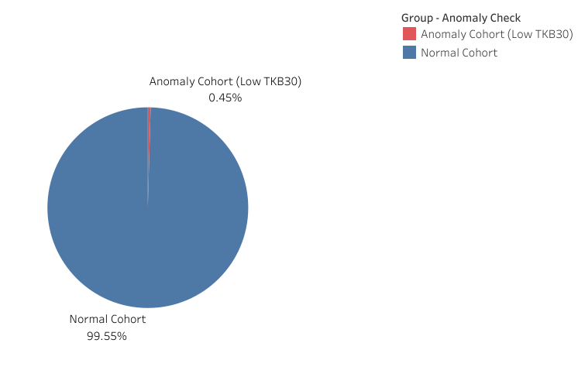
Anomaly vs Normal Customer
In terms of quantity, this Anomaly group is indeed small (a minority), but the financial impact of its losses is significant because its TKB30 has plummeted.

Slide 11
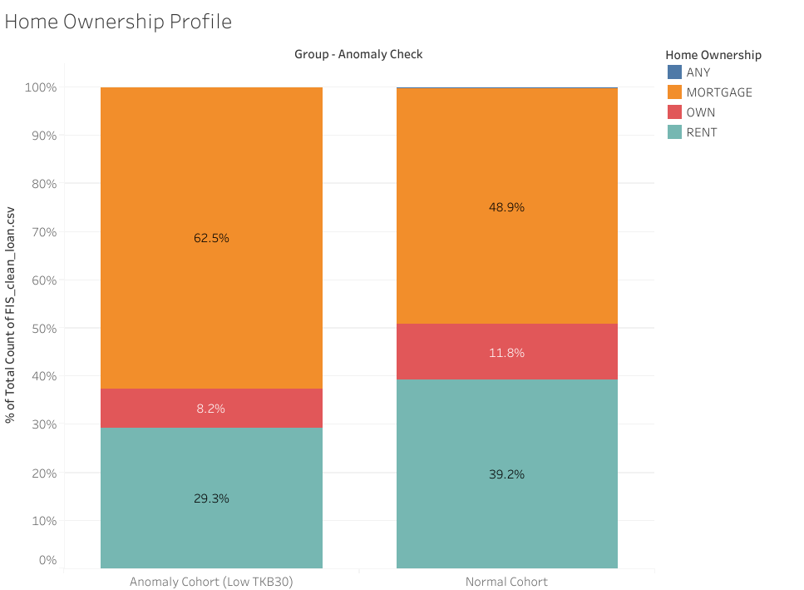
Home Ownership Profile
Anomaly vs Normal Customer
The Mortgage Trap
Renters aren't the villain
The "OWN" is Safety Net
these customers take out new loans (debt consolidation), their cash flow immediately becomes negative. Their entire salary goes toward mortgage payments & new debt payments.
Rejecting a loan application simply because the applicant is “still renting” is the wrong strategy. The problem is not the status of the house, but the amount of money left.
Customers who have paid off their mortgages are the safest. They have more disposable income to pay off their debts to RevoFin.

Slide 12
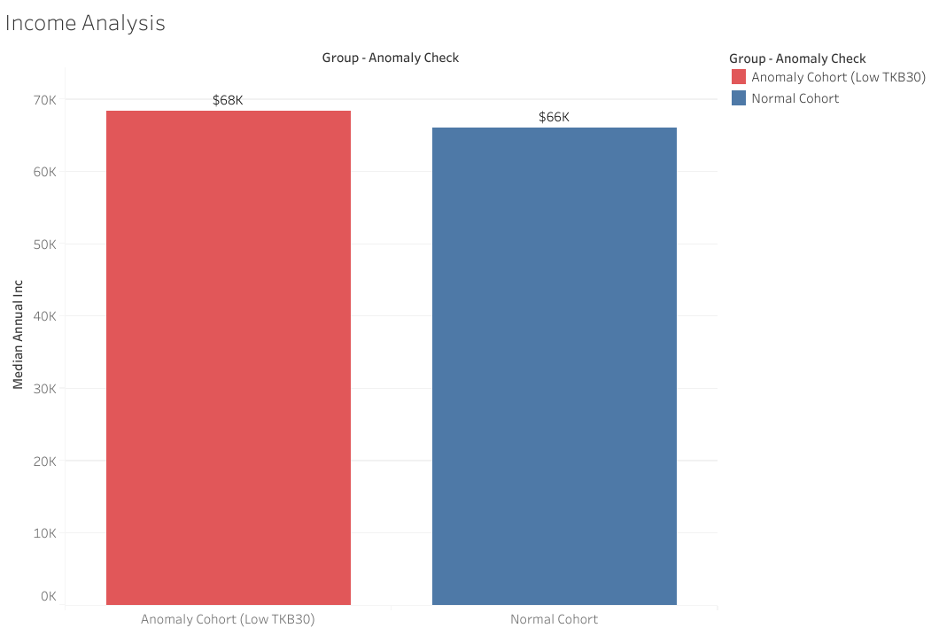
Income Analyst
Anomaly vs Normal Customer
Income is not the main reason for low TKB30
The problem may lie in non-income factors
The anomaly cohort (those with low TKB30) actually had a higher median income, meaning that the problem was not affordability.

Slide 13
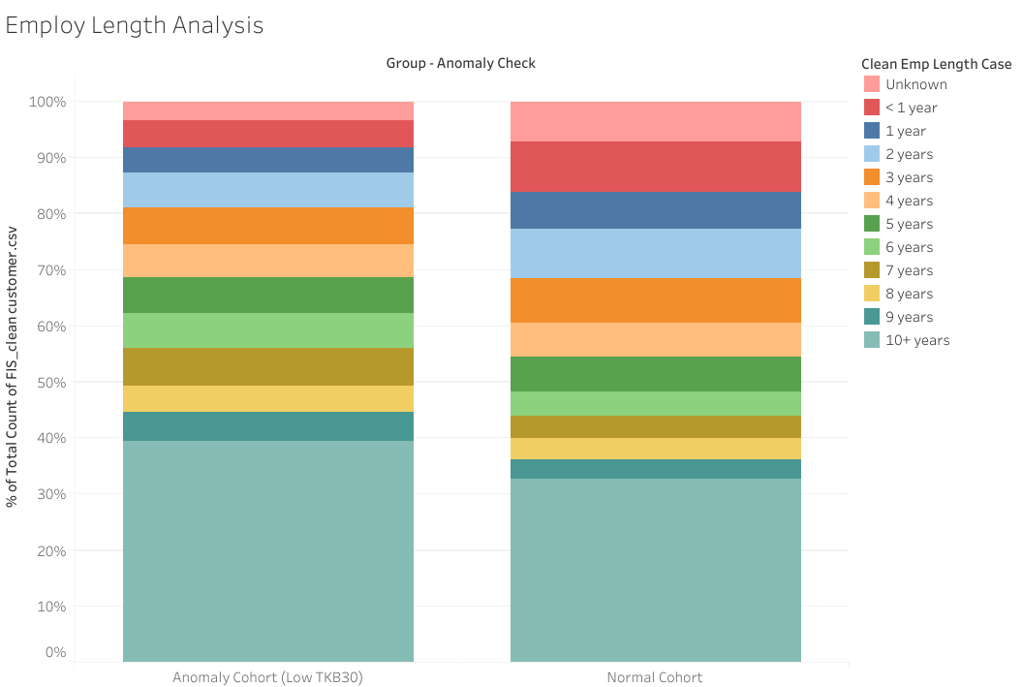
Employment Length Analyst
Anomaly vs Normal Customer
Stability does not guarantee ability to pay
The anomaly cohort appears heterogeneous
It turns out that many senior employees are also trapped in debt (over-leveraged), perhaps because they feel secure and therefore dare to take on a lot of debt.
The presence of many borrowers with 10+ years alongside performance issues indicates that other factors override job stability

Slide 14
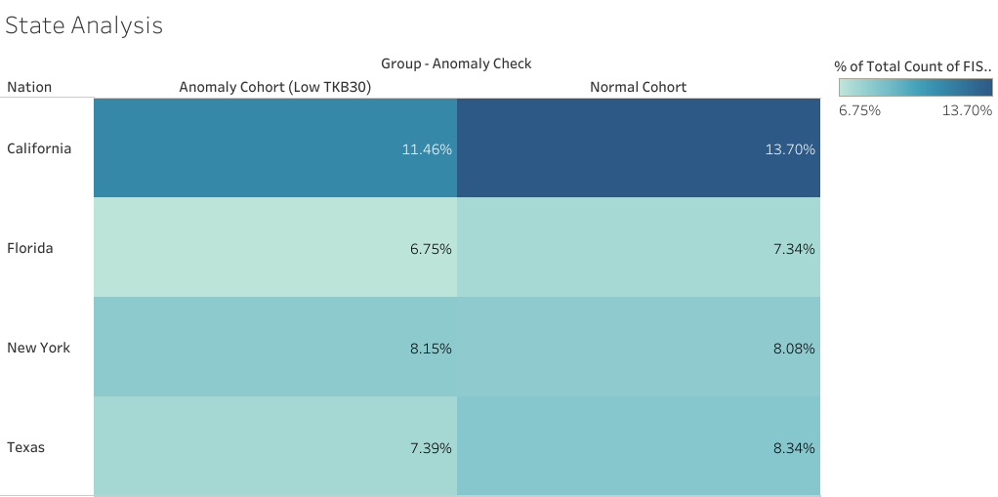
State Analyst
Anomaly vs Normal Customer
Interstate distribution is similar
No single state is clearly the source of the anomaly. The percentages for California, Florida, New York, and Texas differ only by a few points between the Anomaly (Low TKB30) and Normal Cohort. This means that the poor pattern is not concentrated in one large state it is not a single geographical issue.

Slide 15
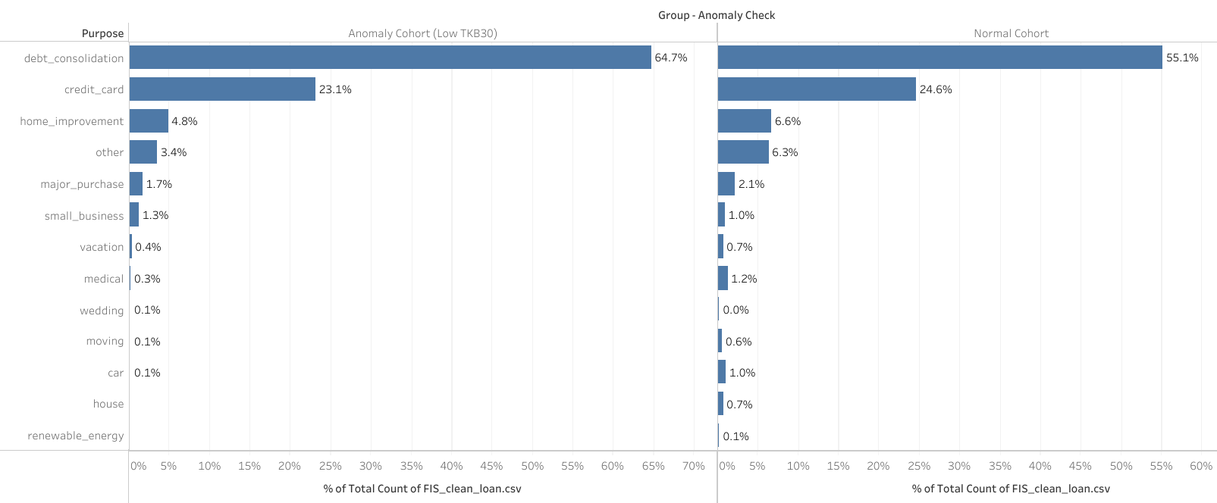
Purpose Analyst
Debt Consolidation dominates the Anomaly Cohort
Borrowers who take out loans to “tidy up” their debts are more likely to fall into the Low TKB30 category.

Slide 16
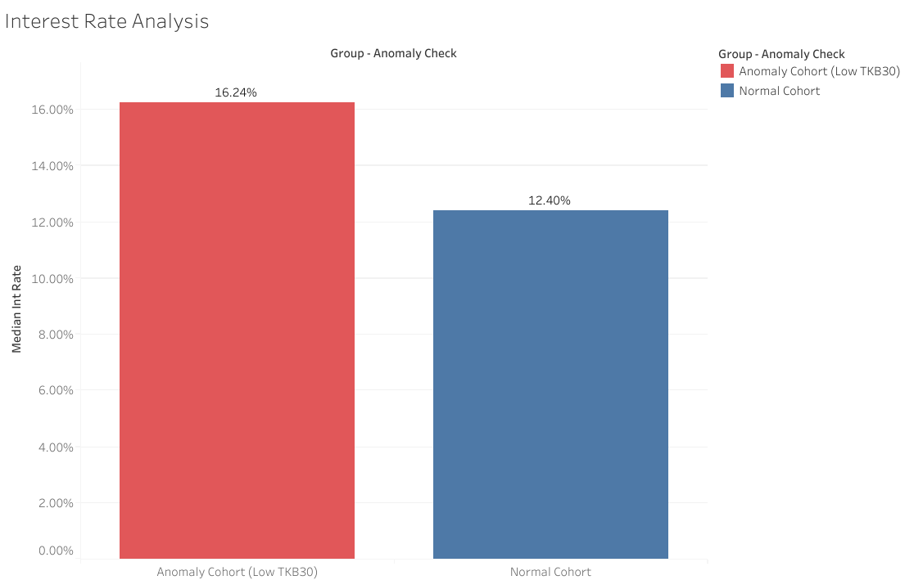
Interest Rate Analyst
Anomaly vs Normal Customer
Borrowers with higher interest rates are
much riskier.
The Anomaly Cohort has a much higher median interest rate (16.24%) than the Normal Cohort (12.40%).
High interest rates increase installment burdens, making borrowers more prone to delinquency and falling into the Low TKB30 category.

Slide 17
03 Insight &
Recomendation

Slide 18



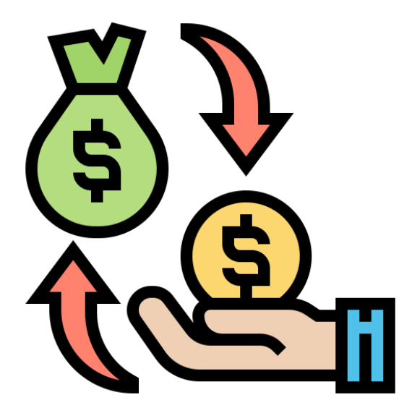
Summary Insight
The Pricing Paradox
Mortgage is a Liability, Not an Asset
We give the highest interest rates (~16%) to people with the thinnest wallets (lower salaries & mortgage payments).
Customers with MORTGAGE status dominate bad credit.
The “Senior Employee” Trap
The “Refinancing” Loop
Many customers with bad credit have been working for 10+ years.
The majority of non-performing loans are for debt consolidation purposes.

Slide 19





RECOMENDATIONS
Volume Lost Opportunity
Bad Debt Saved
Bad Rate Rejected
Benchmark Normal Rate
$566.767.975
$20.842.925
3.68%
1.44%
Short-Term (Months 1-2) - Stop the Bleeding
Limit the Pricing Cap, Specifically for Debt Consolidation purposes

Slide 20

RECOMENDATIONS
Threshold $77673.0
Volume Lost Opportunity
Bad Debt Saved
Bad Rate Rejected
Benchmark Normal Rate
$615.055.050
$111.80.075
1.82%
1.91%
Medium-Term (Months 3-4) - Fix the Filter
You don't have to include the “Home Ownership Credit” factor as a deduction from your salary in order to know how much money you actually have left.

Slide 21





RECOMENDATIONS
Compare Bad Rate
Debt Consolidation
Home Improvement
Risk Reduction
Potential Savings
2.05%
1.72%
0.33%
$328.045.12
Long-Term (Months 5-6) - Pivot to Quality
Target Segment Shift the marketing focus from Consolidation to Home Improvement/Credit Cards for homeowners who have paid off their debts.

Slide 22
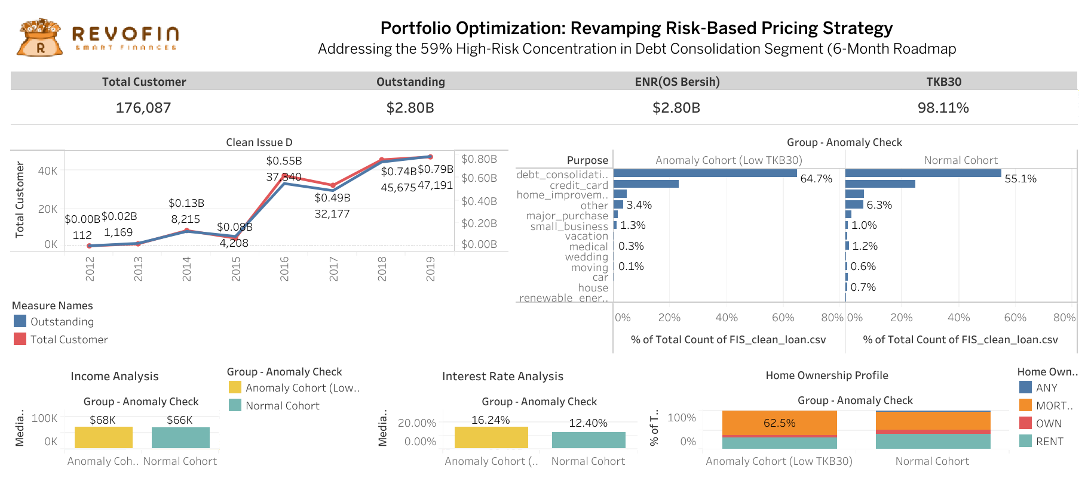
DASHBOARD

Slide 23
Thank You
Contact me Mikhael Putra Iswanto

Slide 24
APPENDIX

Slide 25
Structured Query Language
02
01
03
EDA & Aggregate
Data Cleaning
Anomaly vs Normal
04
05
DPD, KOL, AUM
Impact Analyst

